Slide 2
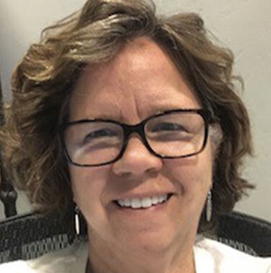
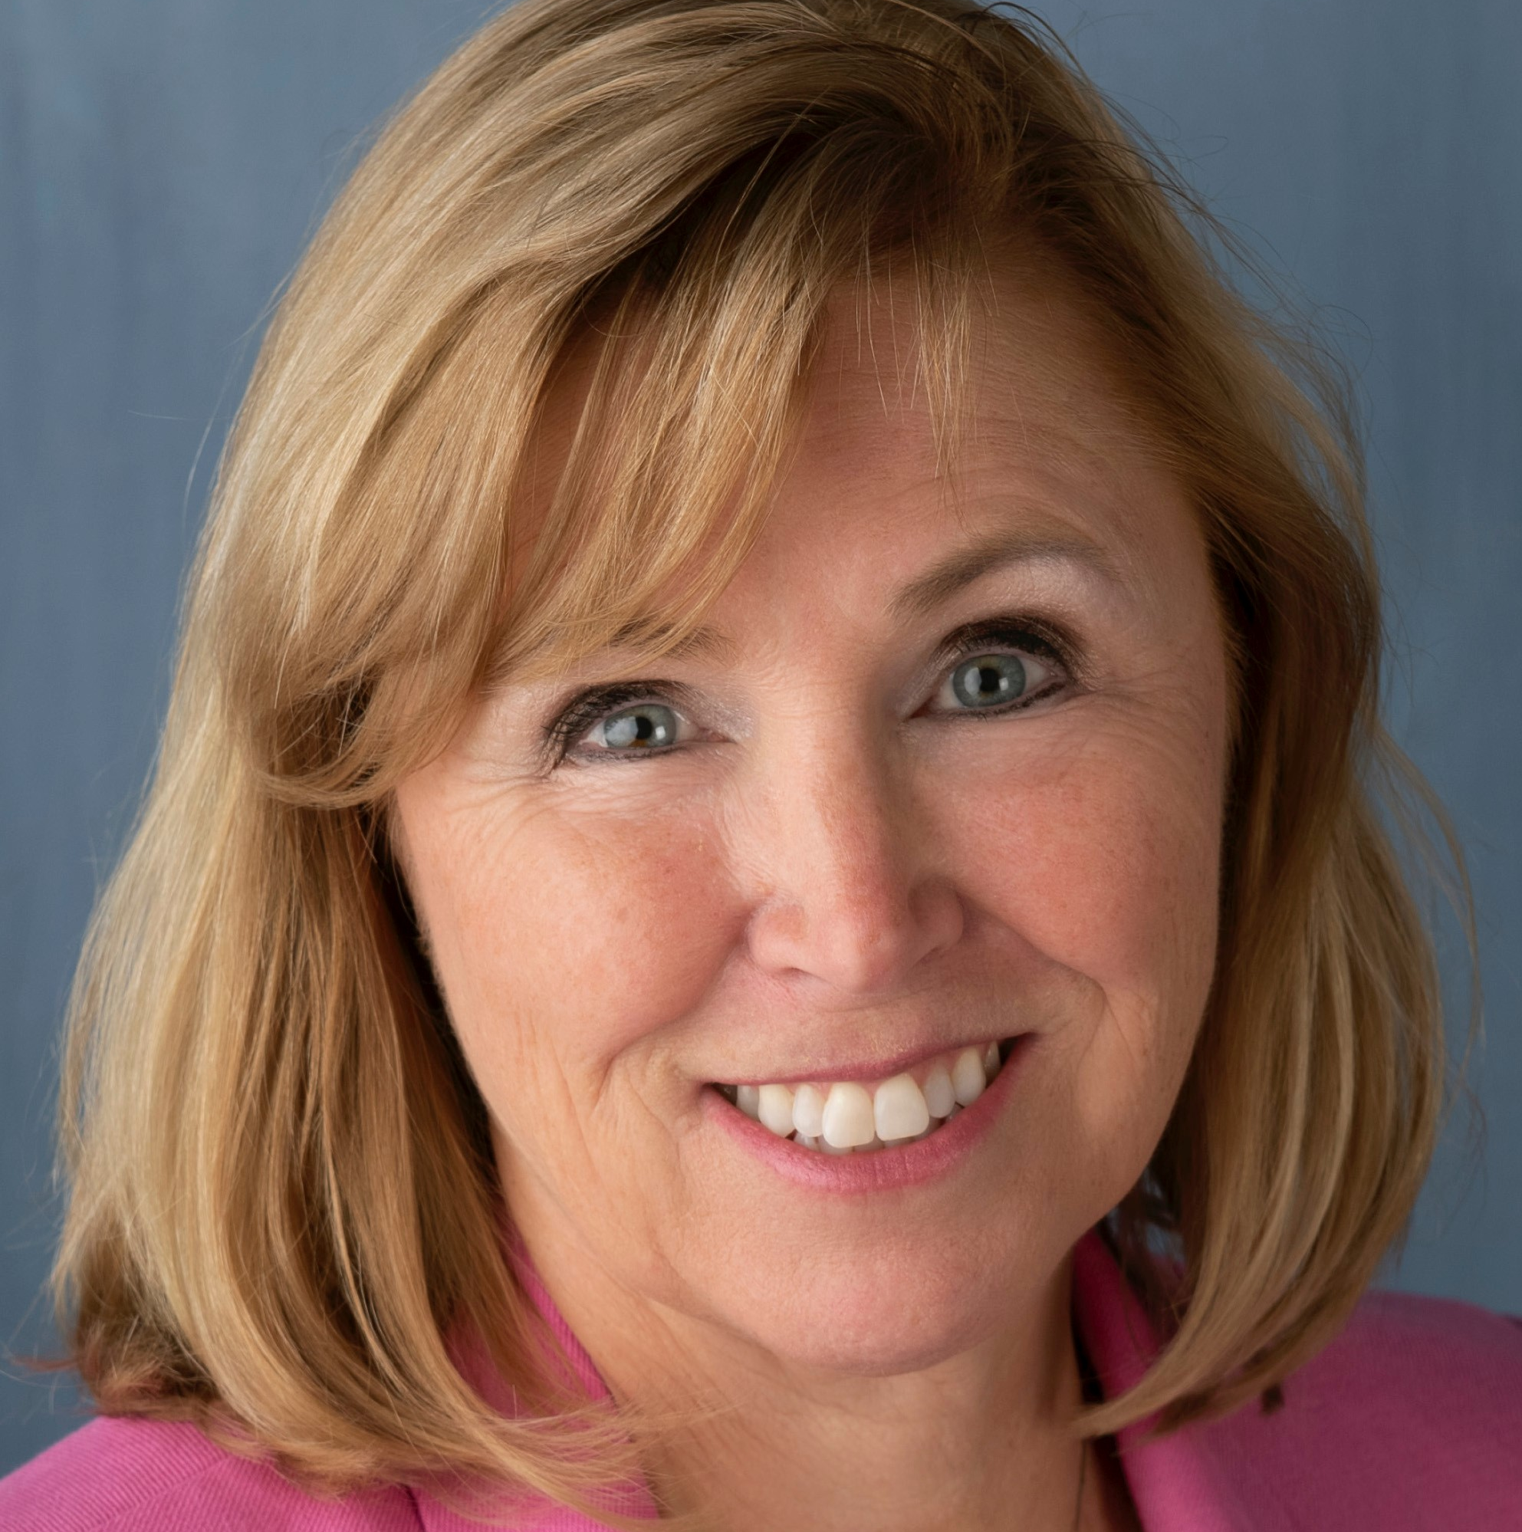
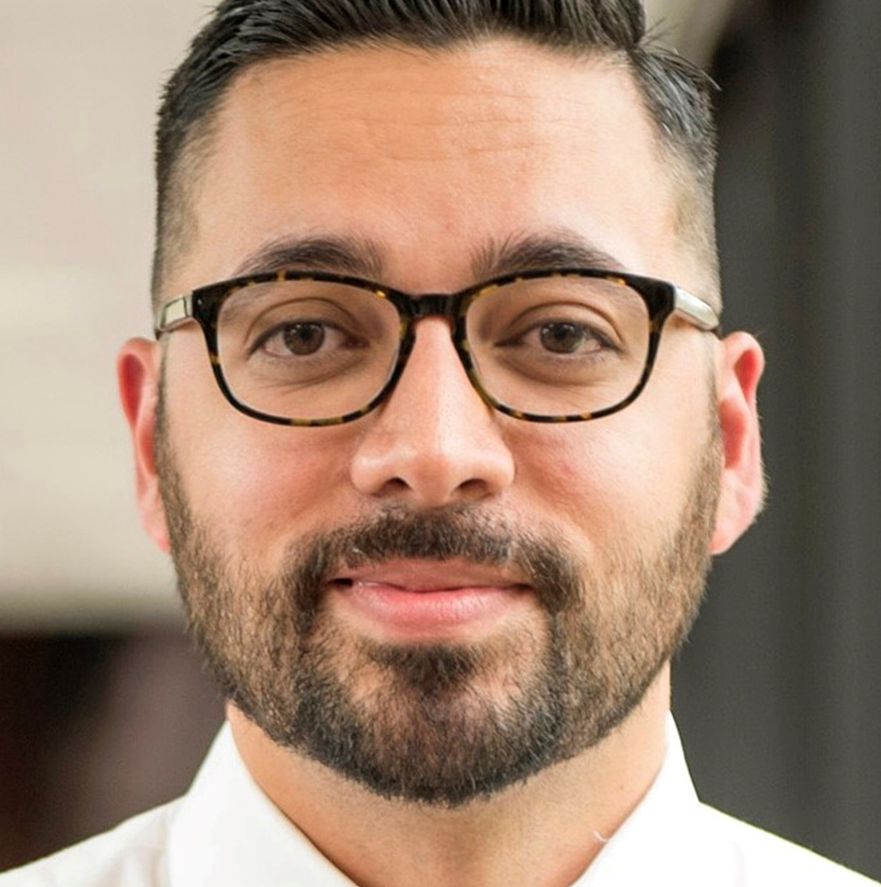
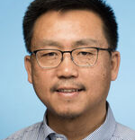
Panelists
Julie Wood, MD
She/her
Lisa Mattson, MD
She/her
Brian Rood, PhD
He/his
Xiangyang (Patrick) Zhao, MD, MS
He/his
Optum Idaho Medical Director
Facilitator
National Medical Director, Optum Health
Panelist
Senior Director, Optum Behavioral Health Solutions
Panelist
Optum Behavioral Health Medical Director
Panelist

Slide 3
Learning Objectives
#1 Define common terms: gender identity, gender expression, assigned sex and sexual orientation
#2 Describe common medical, psychological and social interventions used to support transgender and gender nonconforming individuals
#3 Describe evolving best practices for care coordination among care teams assisting LGBTQIA+ youth and adults in Idaho
#4 Identify common LGBTQIA+ misconceptions and conscious and unconscious biases among health professionals

Slide 5
Resources
World Professional Association for Transgender Health (WPATH) Guidelines: https://www.wpath.org/soc8
Optum support: https://pride365plus.com/

Slide 6
Educational Classes
Caring for the LGBTQ+ Community: Free, accredited, and publicly available series Addresses identities and experiences of the LGBTQ+ community, as well as ways to address the unique health-related disparities affecting the population, including appropriate use of pronouns and terminology | optumhealtheducation.com/health-equity > LGBTQ-101-2021
LGBTQ+ 102: Across the Sexual Orientation and Gender Identity Spectrum: A Call to Action Discusses how stigmatization can adversely affect clinical outcomes, provides awareness around communication needs, and discusses how interactions and documentation can be more supportive | optumhealtheducation.com/health-equity > Across the Sexual Orientation and Gender Identity Spectrum: a Call to Action
LGBTQ+ Mental Health (for Optum providers) Gives providers knowledge and strategies about engaging in effective and affirming communication, discusses leading stressors contributing to poor mental health, and identifies interventions to provide support | optumhealtheducation.com/behavioral-health > LGBTQ+ Mental Health
Overcoming Barriers to LGBTQ+ Affirming Behavioral Health Services (for Optum Idaho providers) | Relias class: REL-BHC-0-OBLGBTQABHS

Slide 7
Questions?
Julie Wood, MD
Optum Idaho Medical Director
julie.a.wood@optum.com

