Slide 1
The Power of Cultural Humility
Sharon Jones, LMFT

Slide 2
It is Okay not to know everything

Slide 3
Community Agreements:
Be kind and courteous
Listen attentively and with an open mind
Share the space
Expect and accept a lack of closure—we won’t get to everything, but we’ll get to as much as possible.

Slide 4
Community Agreements:
If informed that our comment or behavior is stigmatizing or injurious use cultural humility, we will acknowledge and apologize.

Slide 5
Cultural Humility Philosophy
The concept of cultural humility was developed by:
Dr. Melanie Tervalon and Dr. Jann Murray-Garcia

Slide 6
Cultural Humility Philosophy
In a 1998 academic article published in the Journal of Health Care for the Poor and Underserved

Slide 7
Cultural Competence vs Cultural Humility

Slide 8
Cultural Competence Goals
To build an understanding of diverse cultures to better and more appropriately provide services

Slide 9
Cultural Humility Goals
To encourage personal reflection and growth around culture in order to increase service providers' awareness

Slide 10
Cultural Competence Values
VALUES
Knowledge
Training

Slide 11
Cultural Humility Values
VALUES
Introspection
Co-learning

Slide 12
Cultural Competence Shortcomings
Enforces the idea that there can be 'competence' in a culture other than one's own.
Supports the myth that cultures are monolithic.

Slide 13
Cultural Competence Shortcomings
Based upon academic knowledge rather than lived experience.
Believes professionals can be "certified" in culture.

Slide 14
Cultural Humility Shortcomings
Challenging for professionals to grasp the idea of learning with and from clients.

Slide 15
Cultural Humility Shortcomings
No end result, which those in academia and medical fields can struggle with.

Slide 16
Cultural Competence Strengths
Allows for people to strive to obtain a goal.
Promotes skill building.

Slide 17
Cultural Humility Strengths
Encourages lifelong learning with no end goal but rather an appreciation of the journey of growth and understanding.

Slide 18
Cultural Humility Strengths
Puts professionals and clients in a mutually beneficial relationship and attempts to diminish damaging power dynamics.

Slide 19
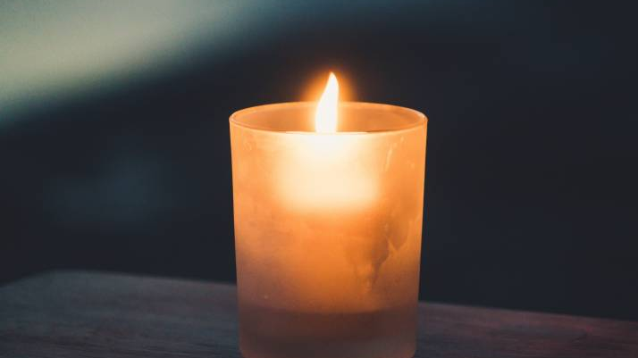
Having a respectful and humble attitude toward other cultures with the realization that what is normative in one's own culture is not necessarily "right" or "better"

Slide 20
Ongoing
Cultural Humility is an ongoing process of self-exploration and self-critique

Slide 21
Learning
An openness and willingness to learn from others.

Slide 22
Relationship
Entering a relationship with people with the intention of honoring their beliefs, customs, and values.

Slide 23
Acknowledging
Acknowledging differences and accepting people for who they are

Slide 24
Self-Reflection
A lifelong process of intentional self-reflection and self-critique

Slide 25
Dynamics
Addressing the power dynamics between provider and client

Slide 26
Each person is multidimensional with a complex cultural identity

Slide 27
ETIQUETTE AND BEHAVIOR
How we greet each other.
What is considered common courtesy.
What is considered impolite.
How we show respect and disrespect.
What is embarrassing.
What makes us feel good.
What we eat and how we eat.
What we wear.
What we buy and how we behave in stores.
How often we touch each other and how we touch
each other.

Slide 28
TIME
How time is scheduled and used.
Whether schedules are important or unimportant.
The importance of maintaining tradition.
The importance of preparing for the future.
Whether old age is valuable or undesirable.
The importance of understanding one's history and passing it on.

Slide 29
BELIEFS AND VALUES
What is beautiful or ugly.
What are worthwhile goals in life.
The nature of God and other religious beliefs.

Slide 30
BELIEFS AND VALUES
Whether a person is in control of his or her own life
or whether fate determines one's life.
Common sense.

Slide 31
BELIEFS AND VALUES
Our perceived needs.
Whether privacy is desirable or · undesirable.
Appropriate health care.
Appropriate personal hygiene.
What is "right"; what is "wrong".
The role of trust.

Slide 32
HUMAN RELATIONS
The role of the individual.
The role and structure of the family.
The roles of men and how men should behave.
The roles of women and how women behave.
The importance of individual competition.
Social class system.
Hierarchy in business relationships.
Interactions between strangers.

Slide 33
HUMAN RELATIONS
How to interact with a person in authority (e.g., boss, police officer, teacher).
How to interact with a person who is serving us.
Relationships and obligations between parents and children and other family members.

Slide 34
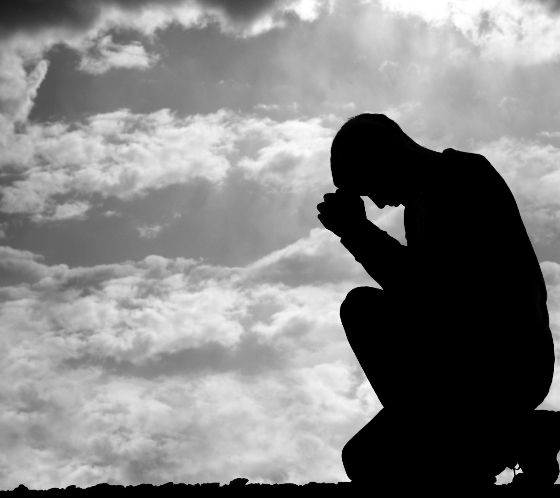
Cultural Humility
Challenges us to think about our own personal biases

Slide 35
Cultural Humility
To collectively learn to truly embrace, appreciate, and live communally with those who are different from us.

Slide 36
Cultural Humility is “not”
Prejudice
Oppression
Intolerance
Discrimination
Stereotyping
Exclusion
Stigma
Inequity
Marginalization
Misconceptions
Labeling
Mistrust
Hostility
Misunderstandings
Cultural imposition
Judgmental
Undermining
Bullying

Slide 37
Cultural humility encourages an active participation in order to learn about a patient's or client's personal, cultural experiences.

Slide 38
Think of a situation that is outside of your normative experience
This Photo by Unknown Author is licensed under CC BY-ND

Slide 39
Let’s have some discussion

Slide 40
Why Cultural Humility? Why it is important to be open to learning all the time?

Slide 41
What are some examples of you practicing cultural humility?

Slide 42
Why is it important for mental health professionals, advocates to know about the importance of cultural humility?

Slide 43
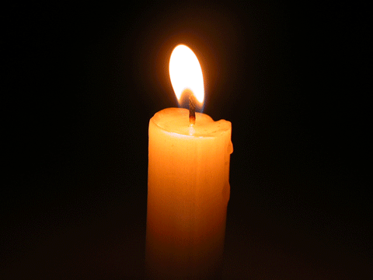
What practices can we add to build Cultural Humility?

Slide 44
What is the power of cultural humility?

Slide 45
What are some present-day values, practices, and policies that are needed to build a culture of humility?

Slide 46
How does this knowledge impact how you think about Your profession?

Slide 47
Remember the Key Attributes of Cultural Humility
Openness
Self-Reflection/Awareness
Lifelong learning
Institutional accountability
Empathy and compassion
To be “other-oriented”
Acknowledging Power Imbalances
Balancing power imbalances
Notes:
Wheeler, Michael. “Cultural Competence and Cultural Humility A Literature Review for Understanding and Action.” tripartners.com, March 20, 2018.

Slide 48
REFLECTIONS

Slide 49
Reflection
Approach every encounter with humility and understanding that there is always something to learn from everyone.

Slide 50
Reflection
Ask what did I learn from each person in that encounter?

Slide 51
Reflection
Think did I treat everyone involved in that encounter respectfully?

Slide 52
Reflection
Hold every person in their highest regard while being aware of and not allowing unconscious biases to interfere in any interactions.

Slide 53
Important Question to Ask
What more do I need to know about this situation?

Slide 54
Thank You for Your Participation

Slide 55
QUESTIONS

