Slide 1
Engaging Parents and Families in Your Practice
Notes:
To use this title animation slide with a new image simply 1) move the top semi-transparent shape to the side, 2) delete placeholder image, 3) click on the picture icon to add a new picture, 4) Move semi-transparent shape back to original position, 5) Update text on slide.

Slide 2
Why is it important to engage families?
Notes:
It is respectful. They know more about their family. Their changes are more likely to be maintained. They have self-determination.
We are more effective!
Tell story of wilderness therapy - hoods in the woods.

Slide 3
Children with families engaged in their education are more likely to:
Earn higher grades and test scores[1]
Graduate from high school and attend post-secondary education[2]
Develop self-confidence and motivation in the classroom[3]
Have better social skills and classroom behavior
Taken from waterford.org/education/how-parent-involvment-leads-to-student-success/ 2022
Notes:
It is respectful. They know more about their family. Their changes are more likely to be maintained. They have self-determination.
We are more effective!
Tell story of wilderness therapy - hoods in the woods.

Slide 4
Therapy
Meta-analyses have demonstrated consistent improvements in child outcomes when parents are involved in treatment across all types of child mental health disorder (Dowell & Ogles, 2010; including disruptive behaviors (Eyberg et al., 2008), attention deficit/hyperactivity disorder (Evans et al., 2014), depression (e.g., David-Ferdon & Kaslow, 2008), anxiety (e.g., Silverman, Pina, & Viswesvaran, 2008), and eating disorders (Keel & Haedt, 2008).
Without Parent Participation it is less likely that therapeutic changes achieved in sessions are generalized to the home setting (Karver et al., 2006).
Notes:
It is respectful. They know more about their family. Their changes are more likely to be maintained. They have self-determination.
We are more effective!
Tell story of wilderness therapy - hoods in the woods.

Slide 5
Research continues to suggest that family involvement leads to improved outcomes for youth at risk for or involved in the juvenile justice system.
Based on their review of the evidence and scan of current policies and practices in the field, the National Research Council (NRC) (2014) included family engagement as one of its seven hallmarks to implementing a developmental approach to juvenile justice
Notes:
It is respectful. They know more about their family. Their changes are more likely to be maintained. They have self-determination.
We are more effective!
Tell story of wilderness therapy - hoods in the woods.

Slide 6
Why don’t we engage families more?
Notes:
It is respectful. They know more about their family. Their changes are more likely to be maintained. They have self-determination.
We are more effective!
Tell story of wilderness therapy - hoods in the woods.

Slide 7
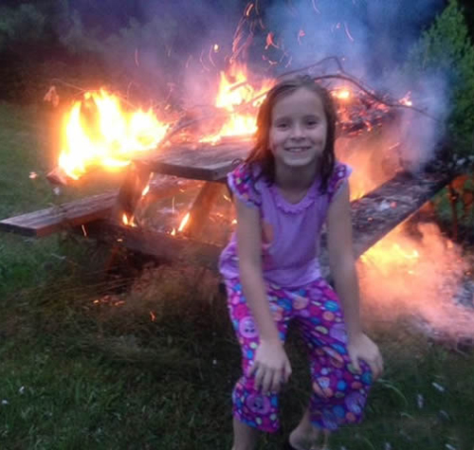
In loco parentis
Notes:
It is respectful. They know more about their family. Their changes are more likely to be maintained. They have self-determination.
We are more effective!
Tell story of wilderness therapy - hoods in the woods.

Slide 8
Didn’t families create the problems?
Notes:
It is respectful. They know more about their family. Their changes are more likely to be maintained. They have self-determination.
We are more effective!
Tell story of wilderness therapy - hoods in the woods.

Slide 9
What is family engagement and how do we get more of it?
ESSENTIAL QUESTION:

Slide 10
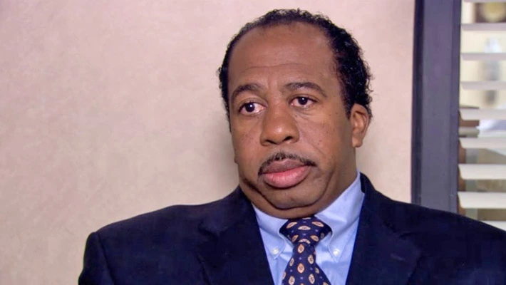
Think of a family or client who is not engaged in your services right now.

Slide 11
How do we measure:
Rates of attendance at the initial intake appointment.
Retention in treatment over time.
Cooperation/Compliance
Task Completion
Engagement

Slide 12
How are we doing engaging families?
No show rates for initial intake appointments ranged from 48% (Harrison, McKay & Bannon, 2004) to 62% (McKay, McCadam, & Gonzales, 1996).
Even conservative estimates indicate that close to 1/3 of children and their families fail to engage at the initial face-to-face intake appointment. (McKay, Lynn and Bannon, 2005)
Notes:
Optimism is not a state - it is a practice. It can be learned and practiced.

Slide 13
Not all Attendance is the Same
The distinction between behavioral and attitudinal components of engagement is significant, given that many clients attend mental health treatment and other services in a perfunctory manner without ever fully investing in the therapeutic enterprise (Staudt, 2007; Staudt, Scheuler-Whitaker & Hinterlong, 2001).
Notes:
Optimism is not a state - it is a practice. It can be learned and practiced.

Slide 14
Engagement
Working relationship - sense of trust and reciprocity
Expectancy - perception of benefit (hope)
Receptivity - openness to receiving help and recognition of problems
Investment - commitment to the process through participation in service planning, goal setting and initiating and seeking help

Slide 15
Working Relationship - A Sense of Trust and Reciprocity
What beliefs do providers need to develop trust and reciprocity with families?

Slide 16
Beliefs of Providers
All treatment is family treatment.
Families know more about their situation than anyone – they are the experts on what will work best for them.
Families are able to formulate their own goals and build their own solutions.
Families tend to maintain solutions they create.
Families are doing the best they can in difficult situations.
Families have a right to be supported in their efforts to improve their own well-being and that of their children.
When parents are supported, most of them can protect their children.

Slide 17
Parents who felt disrespected by their children’s prior mental health providers were six times more likely to doubt the utility of future treatment, and were subsequently likely to identify more structural and contextual barriers to treatment. (Kerkorian, McKay & Bannon, 2006; Robbins et al., 2006).
Notes:
You are not just fighting against the current situation but against their whole history!

Slide 18
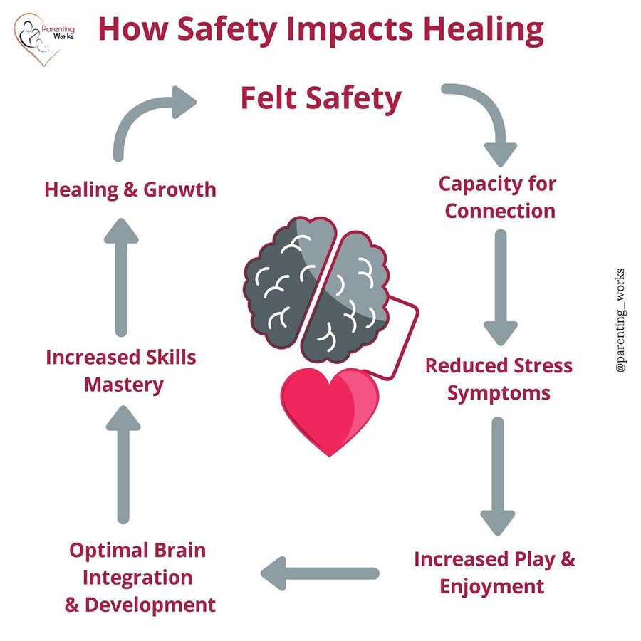
It Starts with Felt Safety
Does the family feel safe with you? Your System?
Is there shame / guilt / stigma associated with your service?
Does your family need to be on guard to protect from judgment?
Notes:
Shame and Guilt.

Slide 19
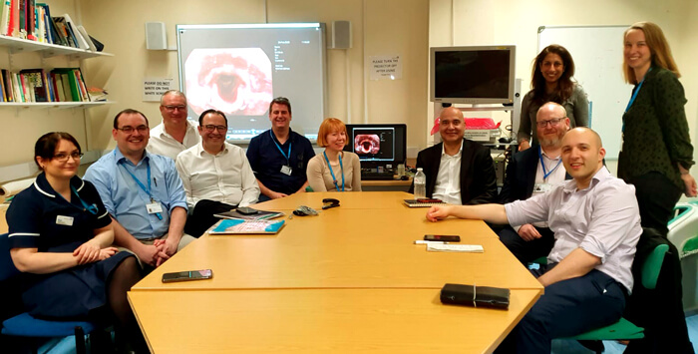

Slide 20
Like Vs Respect
Notes:
Ask what Keith said last year..
If we have time, find your high five partner and tell them all the things you like or liked about the child you originally described

Slide 21
Like Vs Respect
“Would I rather be feared or loved? Easy. Both. I want people to be afraid of how much they love me.”
~ Michael Scott ~
Notes:
Activity – write down all the things you like, appreciate about “your child”

Slide 22
Another lens
What are their Strengths?
What are they good at?
What do they like?
What do you admire or appreciate about them?
What do they have to be proud of?
Take a moment and write down the things you like and respect about this parent/family member

Slide 23
REFLECTION
Do you like and respect this person / family who is not engaged in your services?
Does this person / family believe that you like and respect them?

Slide 24
Engagement
Working relationship - sense of trust and reciprocity
Expectancy - perception of benefit (hope)
Receptivity - openness to receiving help and recognition of problems
Investment - commitment to the process through participation in service planning, goal setting and initiating and seeking help

Slide 25
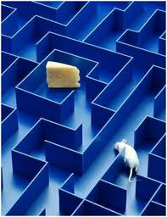
Power of Expectations
Notes:
Ex: 1) Put mice in maze; or 2) told participants their mice were smarter, and the way the people treated the mice actually made ‘em smarter!
Ex: 1) I like this wine better (blind taste-test); or 2) With prices put in front, folks like the more expensive wines (fMRI tests validated the brain activity)
Pygmalion effect

Slide 26
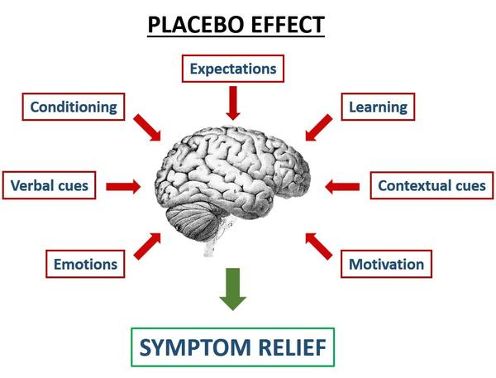
Power of Beliefs (Placebo Effect)
Notes:
With belief that the pill will work, the symptoms go away. A more expensive pill changes the effect even more!

Slide 27
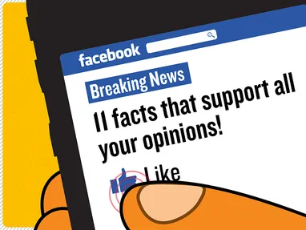
Power of Beliefs (Confirmation Bias)
Notes:
Confirmation bias.
So…do your beliefs matter?

Slide 28
Optimism
“Optimism is the faith that leads to achievement. Nothing can be done without hope and confidence” - Helen Keller
Optimistic people tend to have greater motivation, greater resilience, more positive moods, better relationships, higher achievement and a greater sense control.

Slide 29
HOW TO REFRAME
Step 1: What is going on? What story are you telling?
Step 2: Ask yourself, “Why would a reasonable, rational, decent person act this way?”
Step 3: Find the Noble Intent and “reframe” the story.
…WITH OPTIMISM…
IN 3 “EASY” STEPS!

Slide 30
TRY IT:
Example 1: A driver cuts you off in traffic.
Example 2: You witness a parent yelling at her child.
Example 3: A parent does not show up for an intake appointment for his child
Example 4: A parent who only wants you to “fix that kid” and doesn’t want to see her role in any of the problems.
Example 5: A parent who cancels 50% of sessions/appointments and has a different excuse each time.
WHAT’S THE STORY?
WHAT MIGHT BE THE “NOBLE INTENT”?
REFRAME THE STORY.
Notes:
Example 1, 2, and 3a: We start with an initial reframe; if anyone wants to add/contribute, they can do so.
Example 3b or 3c (depending on if the school is secondary or elementary): We share the scenario and invite contributions (chat or aloud)

Slide 31
YOUR TURN:
What is something that is causing you stress right now?
Share your stressor with your partner, and together follow the steps to reframe the scenario.
*Repeat for your partner’s scenario
WHAT’S THE STORY?
WHAT MIGHT BE THE “NOBLE INTENT”?
REFRAME THE STORY.

Slide 32
2. Expectancy - perception of benefit (hope)
What steps do you take in your practice to increase positive perceptions and help clients / families to feel hopeful?
Notes:
Example of reframing in family therapy - quiet family is good. Angry fighting family is good.

Slide 33
Engagement
Working relationship - sense of trust and reciprocity
Expectancy - perception of benefit (hope)
Receptivity - openness to receiving help and recognition of problems
Investment - commitment to the process through participation in service planning, goal setting and initiating and seeking help

Slide 34
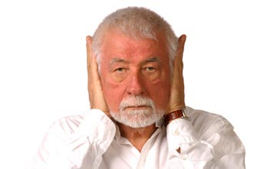
3. Receptivity - openness to receiving help and recognition of problems
If a person or family is not receptive to our services or to change, what do we call them?
Resistant!
Notes:
How do we help them and measure their receptivity/recognition of problems?

Slide 35
Change Questionnaire
Think of a time when you were forced to change. You will not be asked to talk about your situation, just your behaviors and interactions with others that followed.
The situation:
How did you show your resistance? How did you behave?
How did people help you work through it? What did they do or say, and how did they do or say it? What did others say or do that didn't help?
Resistance always has a purpose. What was the positive intent of your resistance? What was going on with you that needed to be taken care of? What made the resistance useful to you at the time?
Source: Alderson, J. & Jarvis, S. (1999). Introduction to supervision for child welfare [curriculum]. Chapel Hill, NC: UNC-Chapel Hill School of Social Work.
Notes:
How do we help them and measure their receptivity/recognition of problems?

Slide 36
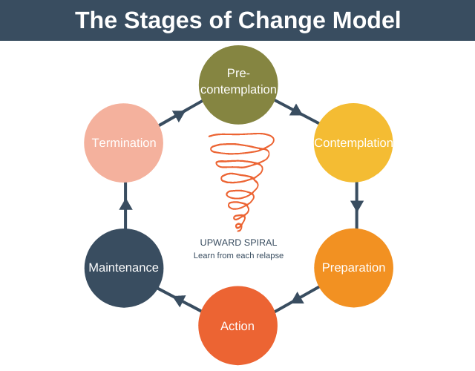
What do we do with resistance?
Notes:
How do we help them and measure their receptivity/recognition of problems?

Slide 37
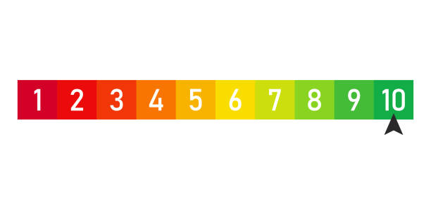
What do we do with resistance?
Scaling questions -
On a scale of 1-10 how important is this for you and your family?
On a scale of 1-10, how confident are you that this will help your family improve?
Notes:
How do we help them and measure their receptivity/recognition of problems?

Slide 38
Engagement
Working relationship - sense of trust and reciprocity
Expectancy - perception of benefit (hope)
Receptivity - openness to receiving help and recognition of problems
Investment - commitment to the process through participation in service planning, goal setting and initiating and seeking help

Slide 39
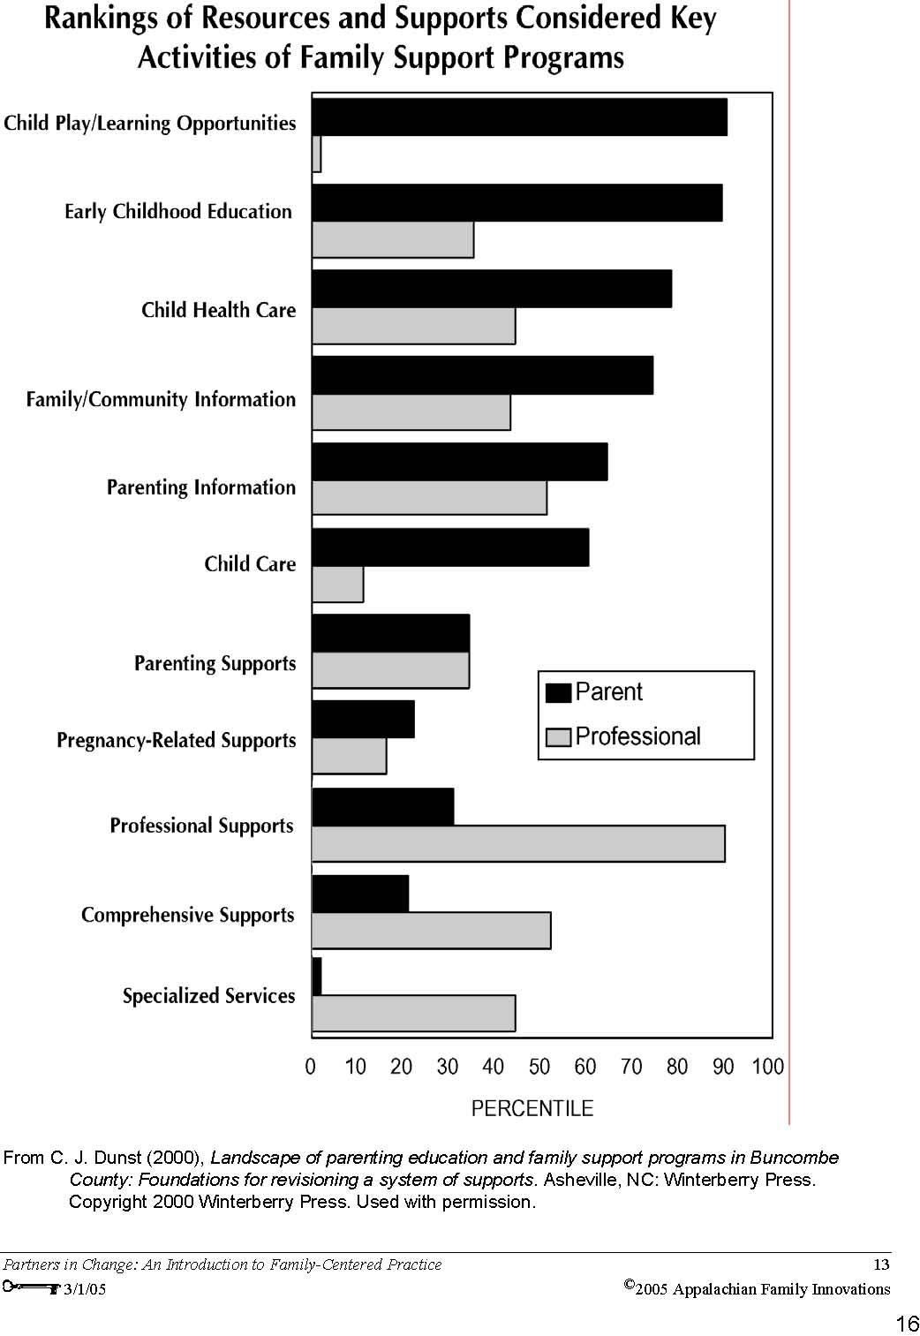
Notes:
Optimism is not a state - it is a practice. It can be learned and practiced.
Optimism WORKS.
Social psychologists have proven this over and over again.

Slide 40
4. Receptivity: Set Mutual Goals
Are the goals set and treatment plan yours or
your clients? What does the family say they
need most?
How much time do you spend with a client/family before you have them set goals and sign a treatment plan?
Treatment attendance increases when parents and adolescents can agree on at least one treatment goal, which may render youth less resistant to investing in the treatment process.
(Brookman-Frazee et al., 2008)

Slide 41
You know all this, why don’t we do it?
Time
Transportation
Resources
Mental health/ Substance abuse
Cultural differences

Slide 42
Take Aways:
What are two things I want to remember?
What is one thing I want to do differently?
Notes:
Optimism is not a state - it is a practice. It can be learned and practiced.

