Slide 1
Modern ECT: Advances, Percepations and Reasons for Hope
Jacob White, DO
Associate Director ECT Service, Cottonwood Creek Behavioral Hospital
General and Pediatric Attending Psychiatrist, St. Alphonsus, St. Lukes, Cottonwood Creek

Slide 2
DISCLOSURE OF CONFLICT OF INTEREST
I have a financial relationship with or interest in a commercial interest connected with this presentation:
Cottonwood Creek Behavioral Hospital is the local ECT center. I perform ECT through that clinic though I do not receive salary or stipend from Cottonwood Creek or compensation in any form connected to referrals or volume of treatment.
DISCLOSURE OF UNLABELED/INVESTIGATIONAL USES OF PRODUCTS
The content of my presentation WILL NOT include discussion of unapproved or investigational uses of products or devices.

Slide 3
Notes:
Born St Luke’s. Always loved Idaho but the widespread idaho pride is new.
First saw ECT as a med student at the Mayo Clinic

Slide 4
Objectives
By the end of today’s discussion, the participant will be able to:
Recognize role of modern ECT in treatment of psychiatric conditions and when to consider recommending treatment
Promote accurate view of potential risks and benefits of ECT and describe treatment experience for patients
Determine physical, social and general psychiatric eligibility of patient to undergo ECT
Explain how active participation in ECT influences concurrent psychopharmacology and individual and group therapies

Slide 5
Outline
Brief ECT history and how modern ECT differs
Indications for ECT (psychiatric and neurological)
Barriers to ECT
How medications and therapy are affected by participation in ECT
Questions/discussion

Slide 6
Roots of ECT
1500’s ~ Paracelsus induces seizures to treat psychiatric conditions.
1934 ~ Von Meduna, successfully treated the first catatonic patient with seizure elicited through intramuscular injections of camphor.
1938 ~ Italian psychiatrist Lucio Bini and neurologist Ugo Cerletti successfully used electricity to cause a seizure to treat a disorganized patient with schizophrenia who improved with 1 treatment and remitted after 11 treatments.
1950’s ~ Introduction of “modified ECT” paralytics began to be included in treatment.

Slide 7
History Since ECT Became an “Accepted” Treatment
“Electroconvulsive therapy is one of the most controversial treatments in medicine.”
70+ years of use, ECT is considered as a safe, effective, and life-saving treatment in people of all ages
As of December 2018, ECT devices were moved from Class III into Class II
ECT an active area of research for decades with an eye to minimizing risks and side effects.

Slide 8
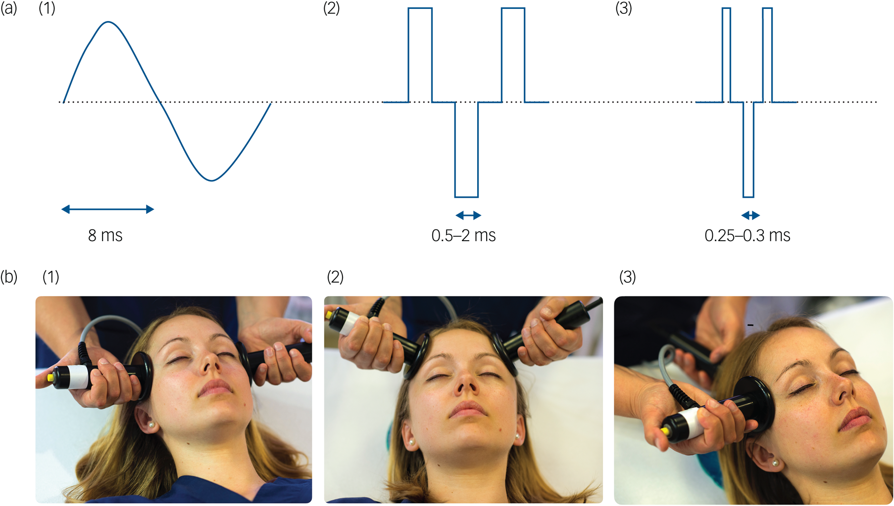
Shift to Brief Pulse ECT
Sine-Wave Brief Pulse Ultra-Brief

Slide 9
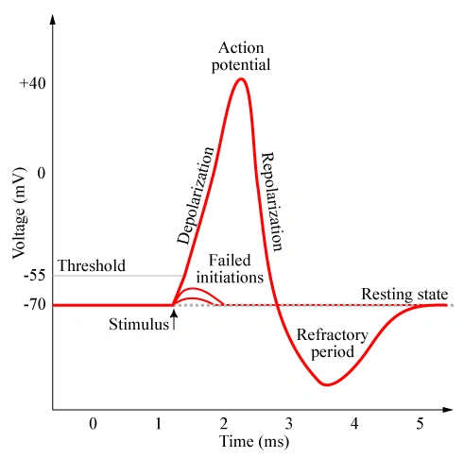

Slide 10
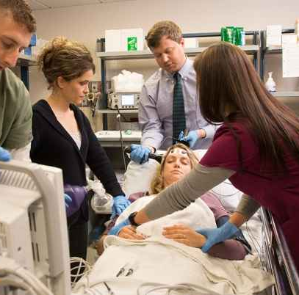
Treatment Experience
NPO evening prior to treatment
Total of 1-2 hours per session
Light, IV anesthesia
Must be retrieved by personal support person

Slide 11
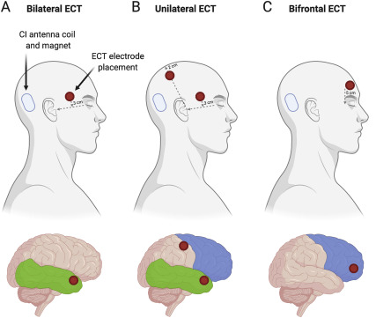
Treatment Parameters
Frequency of treatment
Dose of energy
Pulse duration (width)
Electrode placement
Potency and risk of cognitive impairment of electrode placements:
Right unilateral < Bifrontal < Bitemporal

Slide 12
Variability in ECT utilization
Long-term fluctuations in use
Significant geographic variability
Persons over age 65 with a diagnosis of recurrent major depression were 6.7 times more likely to receive inpatient ECT compared with individuals aged 18–34 years.

Slide 13
Global Variability in ECT
Europe, USA, Australia, New Zealand: elderly patients with depressive disorders.
Asia, Africa, Latin America, Russia: ECT is still often administered without anesthesia, predominantly to younger patients (often more male) with schizophrenia.
ECT is used as first-line acute treatment and not only last resort for medication resistant conditions in many countries.

Slide 14
Contraindications for ECT Treatment:
Cardiac or respiratory instability
Unstable housing
Insufficient social support or transportation
BMI >45
MI or CVA within the last 30 days
No outpatient psychiatrist

Slide 15
Medical Clearance for ECT
Collaborative decision PCP, anesthesia team.
Patient will undergo treatment 3 days a week for 3 to 6 weeks:
General anesthesia with spontaneous ventilation
Electrical stimulus leads to vagal discharge which causes bradycardia and sometimes asystole (pause of > 6 seconds)
General seizure leads to sympathetic response and release of catecholamines causing tachycardia and HTN.
Increase cerebral blood flow which can lead to increased intracranial pressure

Slide 16
Psychiatric Indications for Treatment
Approved Indications:
Severe Depression
Bipolar Disorder
Schizophrenia
Schizoaffective Disorder
Catatonia
Proposed Indications Needing Further Study:
OCD
PTSD
Dementia-Related Agitation
Autism

Slide 17
Neurologic Indications
Approved Indications:
Parkinson’s Disease
Neuroleptic Malignant Syndrome
Proposed Indications Needing Further Study:
Tardive Dyskinesia
Delirium (regardless of underlying cause)
Intractable Seizures

Slide 18
Depression
70% response rate in treatment resistant depression.
First-line in MDD with psychotic features or catatonia, urgent need for response
No established standard of failed antidepressant trials before ECT
Demographic variables are not associated with differential ECT response
Higher burden of comorbid mental health conditions diminishes probability of optimal response to ECT.

Slide 19
Confirm Diagnosis
Ensure patients definitively meet the criteria for a major depressive episode.
Rule out dysphoria better accounted for by PTSD, anxiety, eating disorders, and personality disorders, increased psychosocial stressors.
Assess for psychotic features.
Determine level of impairment due to depression, suicidality, previous treatments for current episode, degree of comorbid psychiatric conditions.

Slide 20
Depression
“If patients are impaired enough to require inpatient admission, then ECT is indicated.”
“Patients who have suicidal thoughts or behaviors should be treated with ECT as well, but the caveat here is that the suicidality should be part of the depressive episode. Patients whose suicidality is related to borderline or another personality disorder or to a non-mood mental disorder probably will not respond well to ECT.”
~Keith G. Rasmussen, Mayo Clinic

Slide 21
Mania
40%−60% of patients with mania respond to pharmacological monotherapy, 20% respond to the combination of an antipsychotic + lithium or anticonvulsant.
80% of manic patients showed substantial clinical improvement or remission following ECT.
ECT was at least as effective in the treatment of mania as in the treatment of depression.

Slide 22
Bipolar Depression
Patients with bipolar depression do not respond differentially to ECT from those with unipolar depression.
Treatment decisions approached in the same way as unipolar depression.

Slide 23
Older Adults
ECT may cause delirium in elderly patients with cognitive impairment.
Depression in late life is also more likely to be medication resistant.
Increased prevalence of delusional depression
Severe inanition, refusal to eat, psychosis, and suicidal ideation are features of depression more common in older adults.

Slide 24
Schizophrenia
25% to 33% of patients with schizophrenia are treatment-resistant
Only an estimated 40% of these will respond to clozapine
50% of patients with schizophrenia who had failed to respond to medications responded to ECT.
Cognitive outcomes improved significantly post-ECT.

Slide 25
Catatonia
ECT response rate one of the highest in psychiatry, >80%
First-line treatment for malignant catatonia, neuroleptic malignant syndrome, in all catatonic patients that are refractory or partially responsive to benzodiazepines.
The presence of acute, severe and psychotic mood disorder is associated with good response.

Slide 26
Memory Impairment as a Risk of ECT
Types of memory variably impacted:
Subjective Memory
Informant-Assessed Memory
Autobiographical Memory
Delayed verbal recall
ElectroConvulsive therapy Cognitive Assessment (ECCA) tool
Retrograde amnesia usually improves within weeks to months after ECT and typically is not evident after 3 months.

Slide 27
Side effects of ECT
-Headaches
-Confusion
-Delirium can occur post-ictally but typically is self limited.
-Muscle soreness
-Nausea and vomiting

Slide 28
ECT and Medication Regimen
ECT performed in addition to concurrent pharmacotherapy managed by referring psychiatrist as well as individual and group therapies.
Medications that increase seizure threshold (benzodiazepines, gabapentin, zolpidem, VPA, lamotrigine, carbamazepine). Hold for 12+ hours prior to treatment.
Lithium leads to increased risk of delirium after treatment, prolonged seizure, prolonged action of paralytic agent. If it cannot be discontinued, hold for 24 hours prior to treatment.

Slide 29
Discussion
Please feel free to contact me at JCWSCHEDULE@GMAIL.COM

Slide 30
Bibliography
1. Sackeim HA. Modern Electroconvulsive Therapy. JAMA Psychiatry. 2017;74(8):779.
2. Slade EP, Jahn DR, Regenold WT, Case BG. Association of Electroconvulsive Therapy With Psychiatric Readmissions in US Hospitals. JAMA Psychiatry. 2017;74(8):798.
3. Association of ECT With Risks of All-Cause Mortality and Suicide in Older Medicare Patients. American Journal of Psychiatry. Published 2021
4. Peterchev AV, Rosa MA, Deng ZD, Prudic J, Lisanby SH. Electroconvulsive Therapy Stimulus Parameters. The Journal of ECT. 2010;26(3):159-174
5. ECT Can Help Patients With Medication-Resistant Schizophrenia. Psychopharmacology. Published 2016
6. Haq AU, Sitzmann AF, Goldman ML, Maixner DF, Mickey BJ. Response of Depression to Electroconvulsive Therapy. The Journal of Clinical Psychiatry. 2015;76(10):1374-1384.

Slide 31
Bibliography
7. Rasmussen KG. Lithium for Post-Electroconvulsive Therapy Depressive Relapse Prevention. The Journal of ECT. 2015;31(2):87-90
8. Kelly KG, Zisselman M. Update on Electroconvulsive Therapy (ECT) in Older Adult. Journal of the American Geriatrics Society. 2000;48(5):560-566
9. Chan CYW, Abdin E, Seow E, et al. Clinical effectiveness and speed of response of electroconvulsive therapy in treatment‐resistant schizophrenia. Psychiatry and Clinical Neurosciences. 2019;73(7):416-422
10. Luchini F, Medda P, Mariani MG, Mauri M, Toni C, Perugi G. Electroconvulsive therapy in catatonic patients: Efficacy and predictors of response. World Journal of Psychiatry. 2015;5(2):182
11. Fox. Are brief pulse and sine wave ECT equally efficient? The Journal of clinical psychiatry. 2022;50(11)
12. Lee JH, Kung S, Rasmussen KG, Palmer BA. Effectiveness of Electroconvulsive Therapy in Patients With Major Depressive Disorder and Comorbid Borderline Personality Disorder. The Journal of ECT. 2019;35(1):44-47

Slide 32
Bibliography
13. Lee JH, Kung S, Rasmussen KG, Palmer BA. Effectiveness of Electroconvulsive Therapy in Patients With Major Depressive Disorder and Comorbid Borderline Personality Disorder. The Journal of ECT. 2019;35(1):44-47
14. Leiknes KA, Schweder LJ, Høie B. Contemporary use and practice of electroconvulsive therapy worldwide. Brain and Behavior. 2012;2(3):283-344
15. Singh S, Jolly A. Does electroconvulsive therapy cause brain damage: An update. Indian Journal of Psychiatry. 2020;62(4):33
16. Sackeim HA, Prudic J, Nobler MS, et al. Effects of pulse width and electrode placement on the efficacy and cognitive effects of electroconvulsive therapy. Brain Stimulation. 2008;1(2):71-83
17. Dhossche DM, Stanfill S. Could ECT be effective in autism? Medical Hypotheses. 2004;63(3):371-376

