Slide 1
Prior Authorization 101
Understanding Prior Authorization and
How to Obtain It
Oct. 19, 2022
The Boise River

Slide 2
Why are we here?
No one teaches you about managed care, despite it being a big factor in obtaining various mental health services—or any health care services for that matter.
More specifically, the concept of obtaining “Prior Authorization” is rarely mentioned in higher education.

Slide 3
Who am I?
Divina Ramos, LPCC
Until recently, I have been the care advocate manager of Optum Idaho.
I have been with Optum Idaho since 2016 and with Optum since 2011. I started out as a care coordinator then transitioned to the role of care advocate. Prior to working in managed care, I worked in direct care and Utilization Review for Acute Inpatient, Residential Treatment, Therapeutic Foster Care and outpatient therapy.
Fun stuff: I live in New Mexico, I have 5 dogs and I love estate sales.

Slide 4
Objectives of this Presentation
Participants will develop an understanding of Prior Authorization as it relates to Optum Idaho.
Participants will become familiar with Level of Care Guidelines and Medical Necessity and how to document it.
Participants will understand the importance of documenting an individualized discharge plan

Slide 5
SOURCES of TRUTH

Slide 6
Network Provider Manual
Provider Manual
Sources of Truth: Provider Manual
Gives you the definition of Prior Authorization
Tells you what services require Prior Authorization
Provides the service description, how it should be provided and who should provide the service

Slide 7
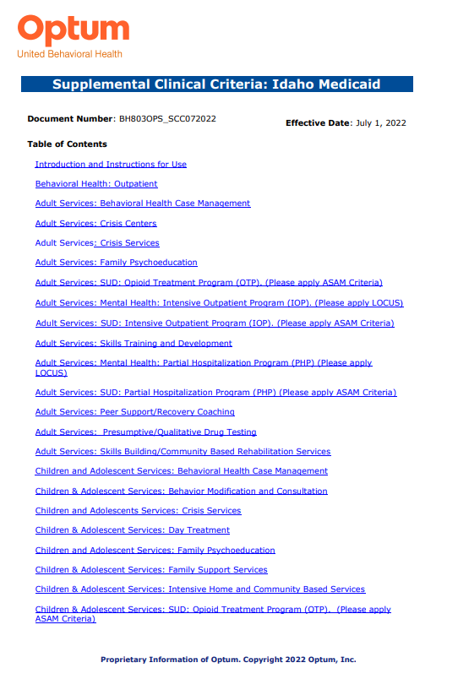
Level of Care Guidelines Idaho Medicaid Supplemental Clinical Criteria
Sources of Truth: Supplemental Clinical Criteria
Provides a service description
Provides the clinical criteria a member should meet for admission, continued services and discharge.

Slide 8
Prior Authorization

Slide 9
Prior Authorization: Definition
From pages 55-56 of the Optum Idaho Network Provider Manual:
For services requiring Prior Authorization, authorization must be requested PRIOR to providing services.

Slide 10
Prior Authorization: Services Requiring Prior Authorization
On page 56 of the Optum Idaho Network Provider Manual:

Slide 11
Prior Authorization: Threshold Services
On page 58 of the Optum Idaho Network Provider Manual:

Slide 12
Prior Authorization: Threshold Services (cont.)
On pages 58-59 of the Optum Idaho Network Provider Manual:

Slide 13
Documenting Clinical Presentation for Prior Authorization
Know your Clinical Criteria
Do this: helpful hints for documenting clinical presentation
Do not do this: things to avoid when providing documentation

Slide 14
Level of Care Guidelines Idaho Medicaid Supplemental Clinical Criteria
Documentation: Know Your Clinical Criteria
Provides the clinical criteria a member should meet for admission, continued services and discharge.
Types of Clinical Criteria:
State Specific
ASAM ASAM Clinical Criteria Information (providerexpress.com)
LOCUS, CALOCUS-CASII, ECSII Adoption of LOCUS/CASII/ECSII for Level of Care Guidance (providerexpress.com)

Slide 15
Documentation: Helpful Hints for Documenting Clinical Presentation
DO THIS:
Read and understand the prior authorization forms. Provide the information requested.
If you don’t have, or you don’t know, the information requested, get it.
Document the individual’s specific behavior, not the symptom of the disorder.
Document frequency, intensity, consequences of behavior and provide context/time-frames.
WRITE DESCRIPTIVELY. Your goal is to paint a picture of the member you’re requesting services for and why they meet the clinical criteria for the service you’re requesting.
If you have questions, CALL US on the Provider Line at 855-202-0983, Opt. 1, and ask to speak with a Care Advocate.

Slide 16
Documentation: Things to Avoid when Providing Documentation
DO NOT:
Quote the ASAM guidelines or the DSM-V diagnostic criteria.
Use a template.
Just because the member wants this service doesn't mean they meet medical necessity for this service.

Slide 17
Discharge Plan

Slide 18
Discharge Plan
Discharge planning begins at admission.
All the services requiring Prior Authorization also require a discharge plan.
While not all Service Request Forms (SRFs) ask about a discharge plan, it is important to know what the member is working towards. This is especially important in requests for continued stay, as the Care Advocate reviewing the request may call you and ask about it.
Know what the discharge criteria is for each service (Level of Care Guidelines Idaho Medicaid Supplemental Clinical Criteria).
Just because the member wants to continue this service doesn't mean they meet medical necessity for this service.

Slide 19
Questions?

Slide 20
References
Optumidaho.com Home (optumidaho.com)
Optum Idaho Forms Forms (optumidaho.com)
Level of Care Guidelines Idaho Medicaid Supplemental Clinical Criteria
Optum Idaho Provider Manual Provider Manual
ASAM Clinical Criteria Information (providerexpress.com)
Adoption of LOCUS/CASII/ECSII for Level of Care Guidance (providerexpress.com)

