Slide 1
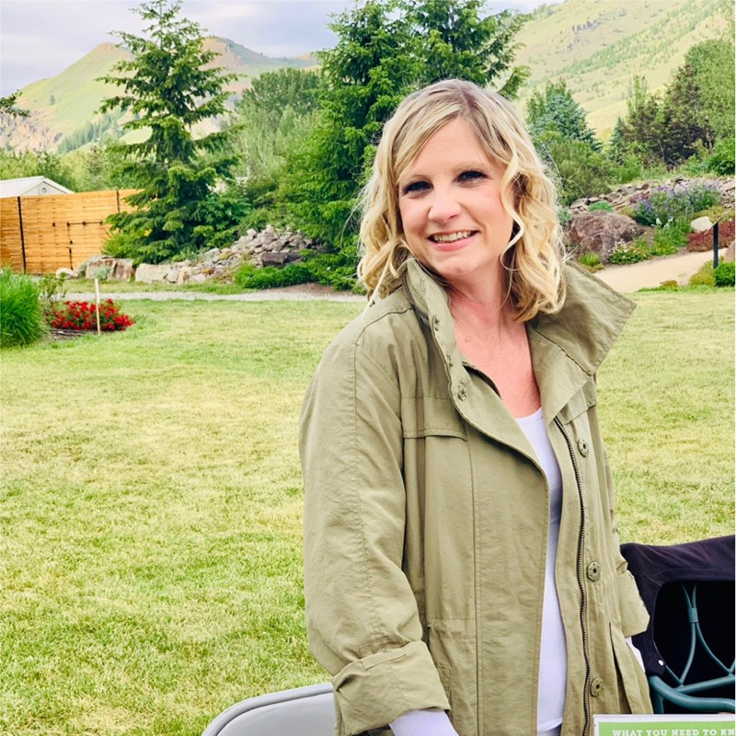
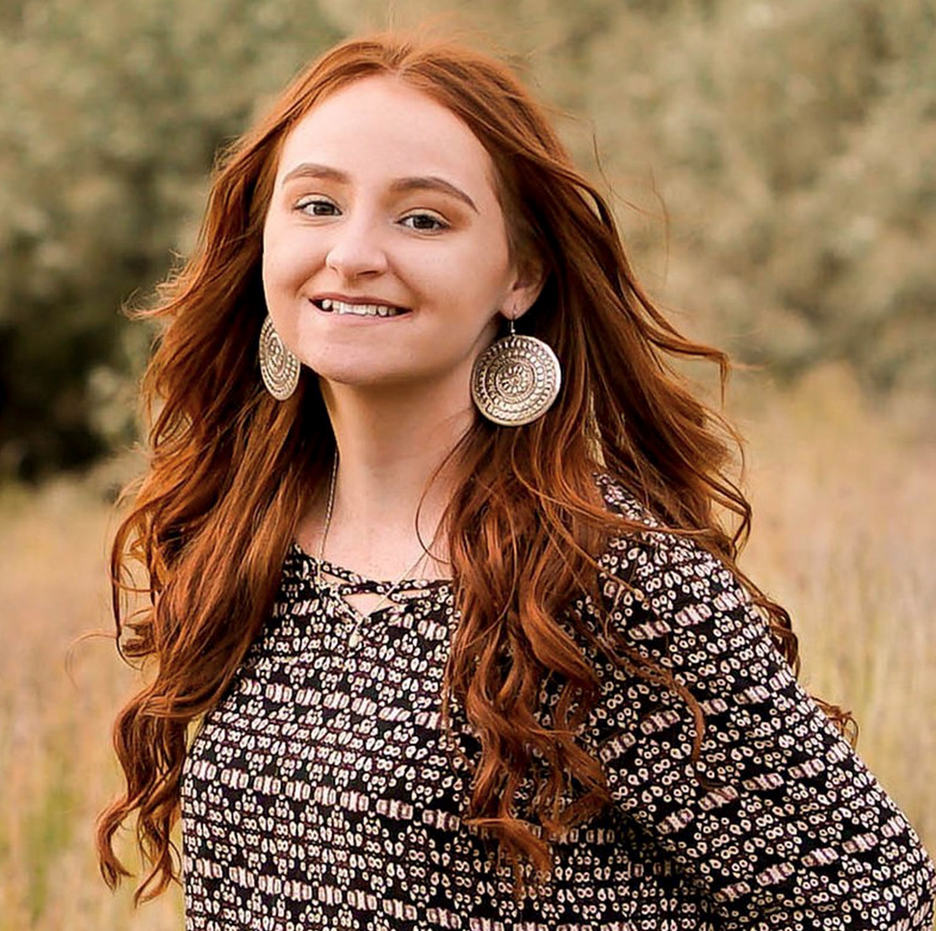
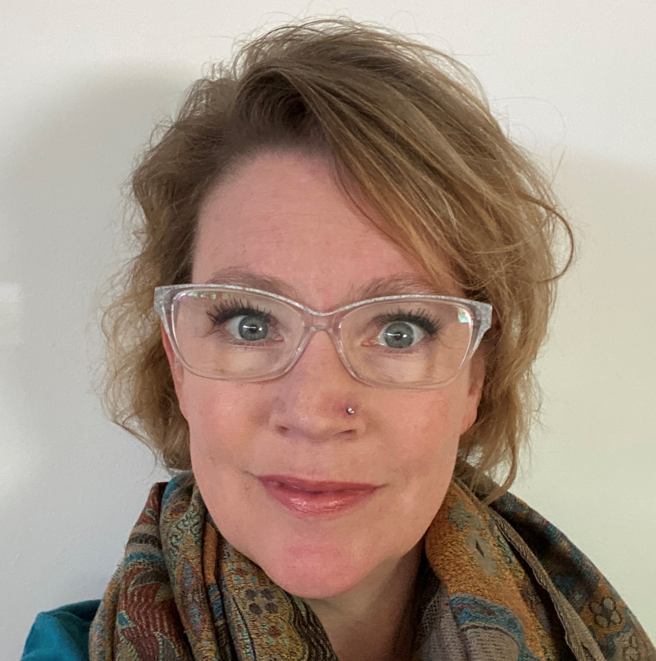
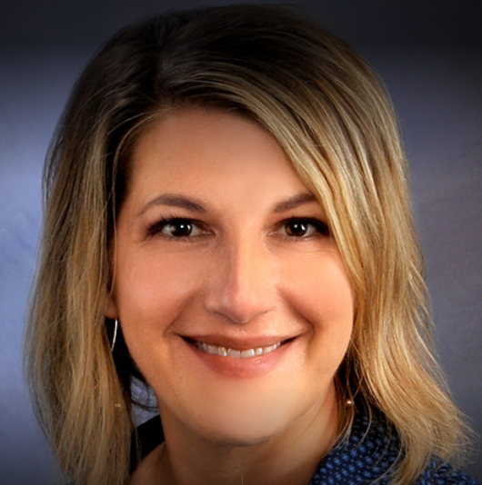
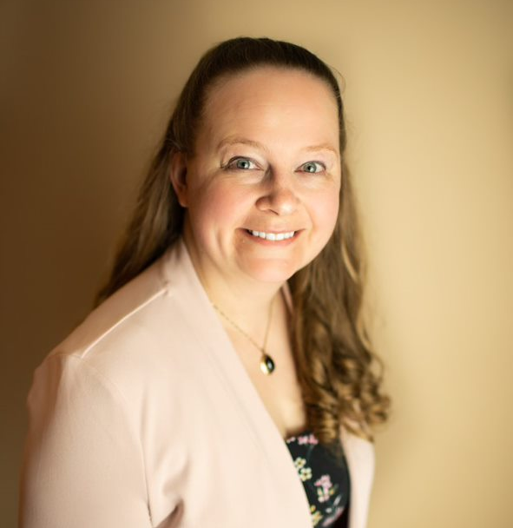
Panel Discussion: Importance of Family Engagement in Behavioral Health Care
Christina Cernansky
Amber Leyba-Castle
Beth Markley
Julie Schmidt
Julie Wittman
Co-chair, Idaho Suicide Prevention Action Collective & Board Chair, NAMI Idaho
Young & Well Coordinator, NAMI Idaho
Executive Director,
NAMI Idaho
Pediatric Mental Health Therapist,
St. Luke’s
BCBA & ABA Therapist,
Valley Applied Behavior Analysis, LLC
Session Facilitator
Panelist
Panelist
Panelist
Panelist

